Slide 1
Hastings Opportunity Area Helen Kay, Programme Director

Slide 2
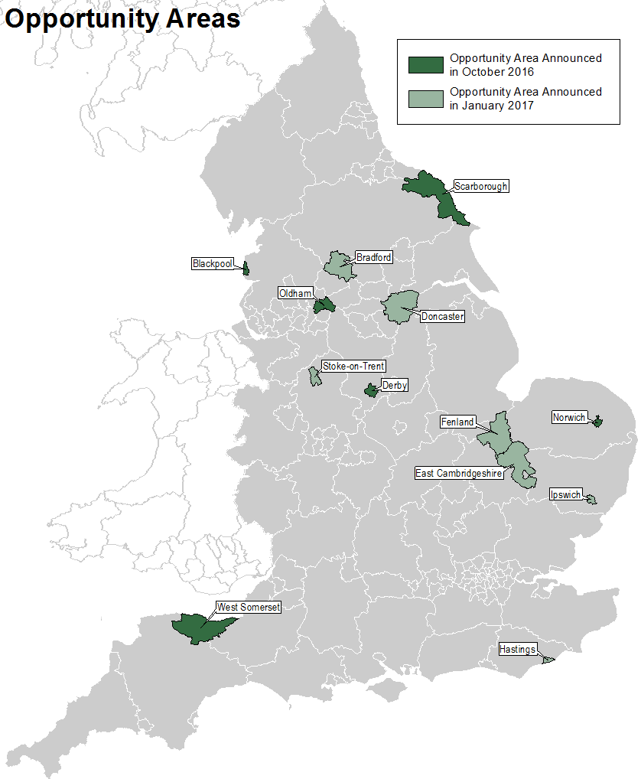
The opportunity areas
Six areas were announced 4 October 2016:
Blackpool
Scarborough
Oldham
Derby
Norwich
West Somerset
A further six areas were announced 18 January 2017:
Doncaster
Bradford
Stoke-on-Trent
Ipswich
Hastings
Fenland and East Cambridgeshire
Notes:
Social mobility is the breaking of the link between a child’s family background and where they get to in life, with their background and destination often measured by social class (which usually looks at their profession) or by income.’
Opportunity Areas will see local partnerships formed with early years providers, schools, colleges, universities, businesses, charities and local authorities to ensure all children and young people have the opportunity to reach their full potential.

Slide 3
Why these 12 Opportunity Areas?
Based on the Social Mobility Commission’s social mobility index and DfE’s education data, areas were identified as facing challenges to social mobility.
Other factors were also taken into account in selecting these 12 Opportunity Areas, including:
Regional spread
Type of area
Local support
The primary purpose of Opportunity Areas is to focus local and national resources on a common goal – to increase social mobility. We want to learn from what works in these initial 12 areas, capturing which challenges all areas share and what is unique to a particular place.
Hastings ranks 282 of 324 on the social mobility commission’s index. It is the only Opportunity Area in the South East.
Notes:
This ranks 324 local authority districts based on a range of indices across the life-cycle, grouped under four headings: early years, school, youth and adulthood.
Regional spread – we wanted to include districts in the north (with a particular focus here because of the Northern Powerhouse), midlands and south
Type of area – we wanted a spread of coastal, urban and rural areas
Local support – we wanted to start with areas we know have the capacity and willingness to participate, as the quickest way to get this off the ground, based on discussions we held as part of our previous cold spots work.

Slide 4
What support will Opportunity Areas access?
£72 million of new funding to support targeted, local work in a small number of Opportunity Areas to address the biggest challenges each of these areas face.
An innovation fund to improve teaching and leadership, worth £75 million, for the most challenging areas of the country, including Opportunity Areas. Call for proposals is now live and we are prioritising OA as part of this.
Investing in improving careers and enterprise provision in Opportunity Areas through the Careers and Enterprise Company.
The National Collaborative Outreach Programme – aiming to increase the number of disadvantaged young people in Higher Education by 2020. (HEPP SY)
Education Endowment Foundation (EEF) Research Schools – £3.5m available to establish hubs of expertise across schools, encouraging research and innovation through interventions proven by the EEF to advance social mobility.

Slide 5
Hastings Opportunity Area
Over Summer 2017, DfE worked with partners to gather and analyse evidence and data about the strengths and challenges across Hastings’ education system, and to investigate some of the root causes
HOA Partnership Board – established – to provide advice, recommendations, support and challenge to the Programme
Working Groups established for key priorities
Delivery Plan finalised and launched
Now in Implementation phase
Notes:
The partnership board (of around 10 – 12 members) will play a key role in Hastings;
There are a range of local representatives including Voluntary Sector, Schools, Local Authority, Voluntary Sector, Local Employers;
Richard Meddings, independent chair;
Partnership Board members will bring expertise and local knowledge to advise the DfE Head of Delivery’s decision making. Jessica Stubbings SLES attends the Board.
Working Groups – set up to oversee and advise on priority areas; ensure synergy and promote coherence across the programmes and existing ESCC priorities.
There have also been breakfast briefings provided to meetings of all Headteachers.
Action plan for the HOA has been developed, currently being signed off by Education Secretary and will start release of the £6m funding.

Slide 6
What will the Partnership Board focus on?
Board – has agreed 4 priorities for the opportunity area:
Improving literacy outcomes;
Improving maths outcomes;
Mental health and resilience;
Broadening horizons and developing new skills for employment.

Slide 7
Improving literacy and maths outcomes;
Children in Hastings have good start in literacy – but this not translating to achievement at KS2 and 3, particularly for disadvantaged pupils
Plan – set of actions to improve literacy across Key Stages, linked to Hastings wide literacy campaign and parental engagement to develop literacy in the home
Achievement in maths across all stages is low
Plan – build on good practice developed via the Maths Hub, attract and grow excellent maths teachers
Working Groups – for Literacy and Maths. Representative from all Academy Trusts in Hastings and the LA (Danielle Cassell, SLES; Celia Lamden, Health Visiting and Children’s Centres).

Slide 8
Hastings Opportunity Area: Literacy
 | Feb - March | April – June | July - Aug | Sept-Dec
Hastings Wide Literacy Campaign Providing up to £250,000 of funding to an organisation with expertise and experience in improving literacy to work with parents and carers, schools and settings, community champions, voluntary organisations and local businesses, to improve literacy skills and reading comprehension.
Improve Literacy teaching SSIF bid to improve language and literacy skills for children aged 3-6 in 15 primary schools in Hastings. Early Years Foundation Stage Teaching Assistants (TAs) will receive training, supervision and specialist support to carry out accurate assessments of children’s levels of language and literacy, set targets, carryout appropriate interventions and track children’s progress.
Early Feb - Small grp mtg to agree priorities
22 Feb –Scoped proposal developed and agreed.
Review procurement to find ways to deliver
Paper to Partnership Board. – 23 February.
June Launch? Link to story telling festival??
Mid March: Literacy campaign out to tender

Slide 9
Hastings Opportunity Area: Literacy
 | Feb - March | April – June | July - Aug | Sept-Dec
Improve teaching of phonics The EEF Research School will provide additional support and training to schools to improve the teaching of phonics. In addition, we will support schools to receive intensive support to improve the teaching of phonics and reading through support from ‘Ruth Miskin Training’.
Parental engagement of early literacy in the home
Early March - Agree schools requiring additional support
April onwards – DC– conversation with Trust/schools re engagement in programme.
May onwards - Named schools – reapply to Ruth Miskin or a/nother evidence based phonics approach – delivered over the Summer
Work out what’s been done and what the gaps are.
Paper to Partnership Board 20 April
Auditing what home visitors etc need.
Agreement on what we want to commission and how to procure this.
Out to tender – cd be through national literacy programme of other means of commissioning
Sept – Start Implementation

Slide 10
Hastings Opportunity Area: Maths
 | Feb - March | April – June | July - Aug | Sept-Dec
Maths mastery training SSIF Bid to raise attainment in Maths at KS2 and KS3 though maths mastery centred teaching, leading training and focused in-school support. 12 Hastings schools to be involved; 8 primary and 4 secondaries.
Increase support from Sussex Maths Hub The Sussex Maths Hub will increase its outreach and programme for Hastings’ schools
Sussex Maths Hub (St Paul’s Catholic College) continues to offer more training in Hastings area – specifically on early years numeracy and supporting the ‘Teach Meets’ see below
STEM Learning begin needs analysis with STEM departments
Report to PB at regular intervals

Slide 11
Hastings Opportunity Area: Maths
 | Feb - March | April – June | July - Aug | Sept-Dec
Leadership Dev and STEM learning Hasting’s secondary schools will receive support from STEM Learning to establish a STEM hub (through the Teaching and Leadership Innovation Fund (TLIF)). 4 mainstream secondaries and Special School (Saxon Mount) signed up.
Post 16 Work with University of Brighton and the National Collaborative Outreach Programme to invest in development for maths teachers in further education, to improve the quality of maths teaching and learning, and enhance the capacity of maths teams.
Develop network of great Maths teachers
STEM Learning begin needs analysis with STEM departments
Work with DfE to review options for post-16 teacher recruitment and retention.
Review possible next steps – emerging from DfE discussions
University of Brighton providing training for Sussex Coast maths teachers
Mid March Hold event: teach 1st, teach now, Hastings Maths teachers (primary, secondary, special, post 16
June – 2 event – networking opps etc
Sept – networking event

Slide 12
Mental health and resilience;
Clear priority for Hastings amongst Heads, parents, young people, voluntary sector and employers
Evidence – linking non-cognitive skills; self-efficacy, self-regulation, emotional and social skills with improved outcomes
Plan – support implementation of whole school and college approaches to promoting mental health, including training for mental health leads and champions in schools; Building capacity of effective external mental health support with focus on younger children; Develop universal approach to supporting families
Working Group – representatives from Health, Voluntary Sector, Academies incl Brian Hughes, Early Help; Nathan Caine, SEND and Penny Nice ISEND.

Slide 13
Hastings Opportunity Area: mental health
 | Feb - March | April – June | July - Aug | Sept-Dec
Deliver training programme to support all schools and colleges deliver whole school approach to mental health Develop self-assessment for schools Funding for schools – to free up staff re engagement in Audit and mh work Schools carry out self-assessment - with support Schools review together – self-assessments and training/support required Development of ‘menu’ of training for schools – re whole school approaches Delivery of training for key staff in schools re whole school approaches
Brighton self-assessment reviewed at mh working group
Adapt Brighton self assessment for Hastings schools – HK to draft??
Review self assessment with Hastings schools – review in light of feedback
Agree backfill funding for schools to take part in SA
Agree proposal of ‘consultant support and release for SENCOs for schools re MH
April – consultant to begin
End April – meeting of schools to review findings of self assessment and review menu?
Self-assessment work in schools
June onwards – training of leads in schools re MH
Agreement on ‘package’ of training/support for their schools
Roll out of whole school trainings

Slide 14
 | Feb - March | April – June | July - Aug | Sept-Dec
Expand I-Rock. Proposal to increase capacity of I-Rock from 3 days a week to 5 days a week for 14-25 year olds. Proposal for increased capacity – to be reviewed by core ‘project team’ – end February. To include funding required and staffing for the service. Funding agreed and in place Additional staff recruited and trained Increased service to be launched and up and running. Develop I-Rock Service for younger pupils, delivered via schools Develop initial proposal for how service to be delivered March 2018 Consult on proposed ‘model’ with yp and schools; (April – following on from Audit) Refined model in light of comments (June) Recruit/second staff to model (June – August) Service begins – September
Hastings Opportunity Area: mental health
End Feb – proposal for expansion of I-Rock, including staffing and funding of this to be reviewed by project team and agreed in principle.
March 16 – paper on plan and funding proposal to Board for decision
March 16 – April – contract variation re I-Rock agreed CCG/ESCC, SPFT.
April– June – appoint/second staff to the increased service
End June onwards: Increased service delivered.
Discuss initial high level proposal – end Feb
Further dev model.
Consult on proposed model.
Agreed funding and staffing of model.
Further refine model in light of comments.
Recruit/second staff.
Service Begins.

Slide 15
Hastings Opportunity Area: mental health
 | Feb - March | April – June | July - Aug | Sept-Dec
Expand Early Help Parenting Offer Scope extended offer and new strands of offer and delivery structure Appoint/second staff to increase service/agree backfill funding for staff in schools to take part in training and engage in supervision/reflective practice sessions (linked to whole school mh work) Co-ordinate network event with focus on family support and well being – engaging with key local providers, schools, vol sector Agree overall social media campaign approach re mh and parenting work
End Feb – proposal for extension of offer and delivery structure for this – to be reviewed at meeting (also reviewing I-Rock proposals)
March 16 – funding provisionally agreed
April– June – appoint/second and staff to the increased service
End June onwards = Training for staff in and linked to schools re Triple P.
Ongoing supervision/reflective practice sessions for staff involved in delivery of Triple P
23 Feb – initial planning mtg for event
26 April – Network meeting takes place
Discuss initial high level proposal – end Feb
Develop detailed spec and commission org to deliver
Commission social media campaign
Deliver Social Media Campaign
End April – mtg with schools to review Self-Assessment Audit
20 April: Paper to Board on proposed ‘package’ of training/support and possible ‘menu’ of interventions and possible delivery routes (incl. vol sector small grants scheme)

Slide 16
Broadening Horizons and Preparing Young People for Work;
Pupils in Hastings are overall less likely to progress into sustained further education post 16
Plan – all Hastings secondary school and college pupils to receive at least 4 meaningful encounters with employers; support schools to engage proactively with local employers; introduce an entitlement to high quality, regular enrichment for all pupils across Hastings
Working Group – Chair Graham Peters, East Sussex Local Enterprise Partnership, Representatives from HBC, Voluntary Sector, Employers, and LA – Caroline McKiddie SLES.

Slide 17
 | Feb - March | April – June | July - Aug | Sept-Dec
CEC commitment to recruit Cornerstone employers and deliver 4 meaningful encounters CEC procurement of orgs to deliver employer encounters Careers and enterprise co-ordinator – working with Hasting’s schools to support their employer encounters and engagement and make schools aware what is available Delivery of additional employment encounters – with schools drawing down from menu of providers begins
Support schools to understand performance against Gatsby principles, and improve career provision Sept 17 – Sept 18: ongoing activity with schools to support schools map performance against Gatsby Benchmark Training for schools on Compass and Tracker Tools (re Gatsby principles)
Hastings Opportunity Area: Broadening Horizons
2 March - Successful applicants for delivery of additional employer encounters - to be placed on CEC menu of activities announced
18 March - monthly reporting on employer encounters begins – on monthly basis for remainder of programme.
Sept – delivery of additional employer encounters begins
26 Feb – training for all schools
March onwards – schools offered ind training by Careers and Enterprise Co-ordinator.
Sept – delivery of additional employer encounters begins

Slide 18
Hastings Opportunity Area: Broadening Horizons
 | Feb - March | April – June | July - Aug | Sept-Dec
Appoint enrichment co-ordinator and deliver enrichment activities for all children aged 5-18 to begin Summer 2018 Recruit enrichment co-ordinator. Develop and consult on charter for cyp Map and pull together existing enrichment activity and providers Grants programme – for additional enrichment activities/grants to schools/tender significant projects?
Deliver inset day programme
16 Feb. Agree Enrichment co-ordinator JD and job level.
End April/Early May. Enrichment Co-ordinator in post.
Advertise role and recruit
Final proposal – presented to EFT mtg
Early April - Proposal for funding programme –ie grant to schools/grants programme for individual providers) – test out with schools and others
Develop and consult on Charter for Hastings c/yp
Map and pull together existing enrichment activity and providers – engagement with schools/providers/yp to map , review and develop plan for action
April-May: Grants programme advertised and decisions made
June – additional enrichment work begins. Detailed programme of activities in place – June onwards
21 Feb. Proposal for inset days enrichment activity – developed for Board.
March - Consult with yp, schools and providers on proposal – inset days, 10 possible ideas for engagement, proposal for deliverability, scope projectetd numbers and needs etc
April – Draw up specification. What we want to deliver. Agree detailed project plan with schools/colleges re inset days. Put/invite potential orgs onto ESCC framework agreement.
May – June: Carry out short competition re orgs to deliver
End June – Appoint orgs to deliver – 2-3 inset days over the course of the programme
July/Aug - review logistics re delivery with orgs and schools for 1 and 2 inset days
Jan – 2 inset day
Review learning and re-tender where required.
Oct – first inset day

Slide 19
Next Steps:
Mental Health - Detailed papers – agreed by the Board: Expansion of I-Rock, Mental Health in schools and expansion of parenting programmes;
Commission expansion – contract variation, backfill funding to schools/college;
Broadening Horizons – work with schools re what they already offer re enrichment, test out ‘Hastings Children and young people’s charter’ and plans for Inset Days;
Agree – most effective way of commissioning providers to deliver the work: Grants/ESCC Framework;
Detailed papers – on overall approach to the Inset Days and Enrichment Offer;
Recruit enrichment co-ordinator;
Additional enrichment activities in schools to begin – June 2018;
First Inset Days – Autumn Term 2018.

Slide 20
Contact Details
Contacts:
Helen Kay Programme Director
Helen.kay@eastsussex.gov.uk
01323 466 864

